Slide 1



Slide 2


Slide 3


Slide 4
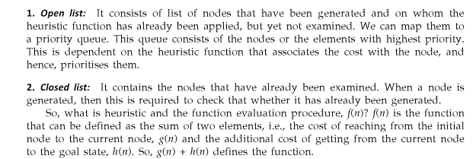

Slide 5

Best First Search Algorithm

Slide 6
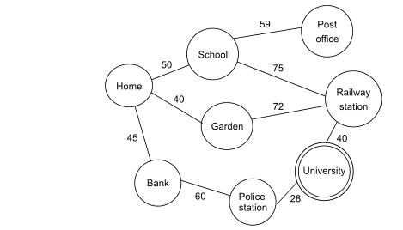
Best First Search

Slide 7
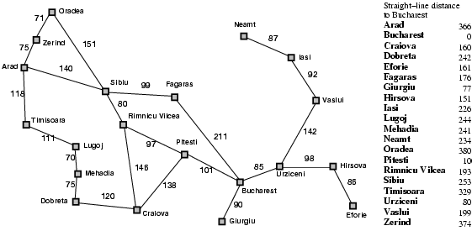
Romania with step costs in km

Slide 8

Greedy best-first search example

Slide 9
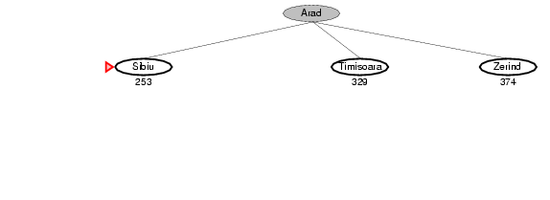
Greedy best-first search example

Slide 10
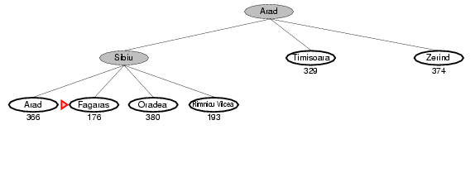
Greedy best-first search example

Slide 11
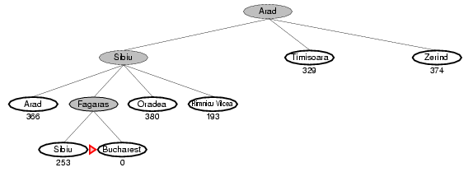
Greedy best-first search example

Slide 12


Slide 13
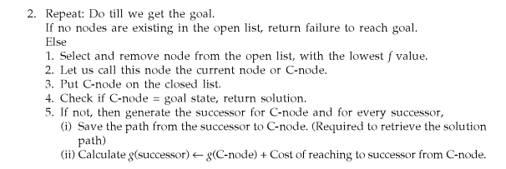
A* Algorithm

Slide 14
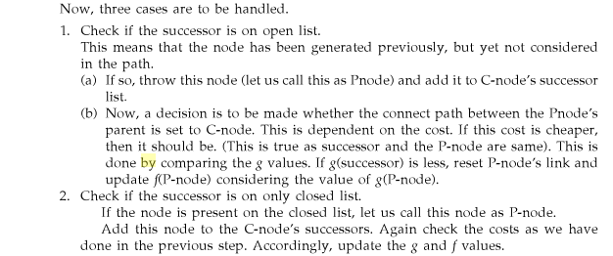
A* Algorithm

Slide 15

A* Algorithm

Slide 16
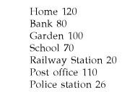
A* Algorithm

Slide 17
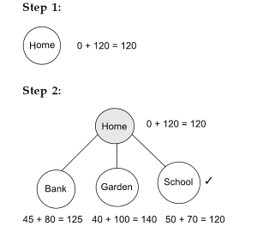
A* Algorithm

Slide 18
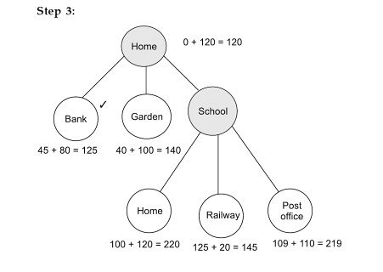
A* Algorithm

Slide 19
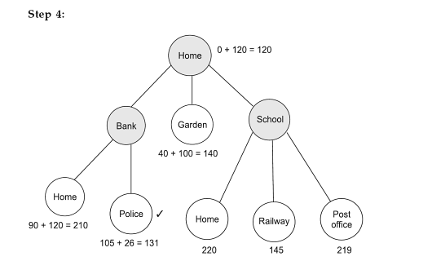
A* Algorithm

Slide 20
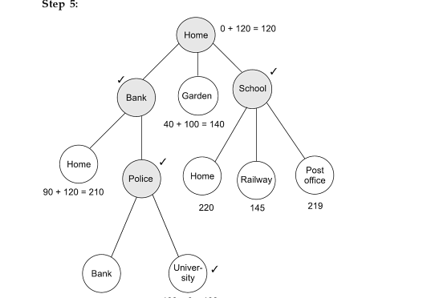
A* Algorithm

Slide 21

A* search example

Slide 22
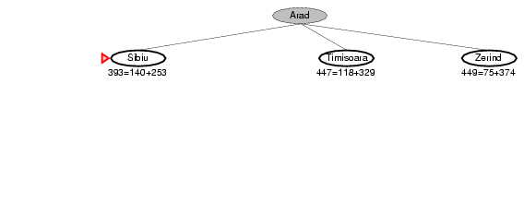
A* search example

Slide 23
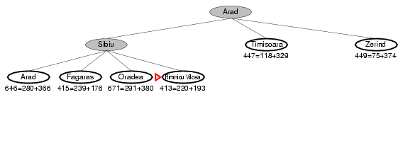
A* search example

Slide 24
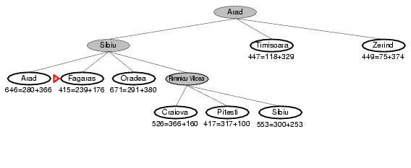
A* search example

Slide 25
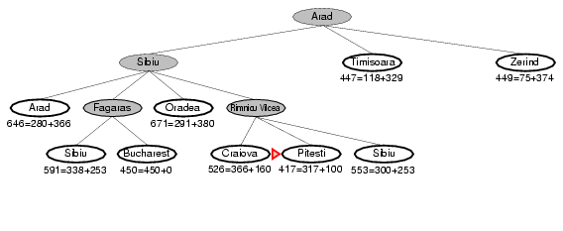
A* search example

Slide 26
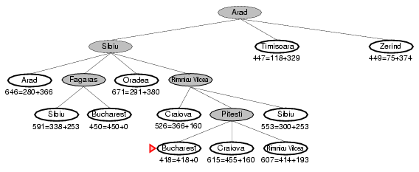
A* search example

